Slide 1
Diabetes Prediction App
Hisham Youssry Machinfy – 2025

Slide 2
Introduction / Problem Statement
Problem: Diabetes is a major health issue worldwide.
Goal: Build a machine learning model to predict diabetes.
This application is designed to predict diabetes status (Healthy, Prediabetic, Diabetic) using clinical health data and a machine learning model. The goal is to raise awareness about diabetes risk and provide a practical tool that can support both medical professionals and the general public.
Importance: Early detection can improve treatment and save lives.

Slide 3
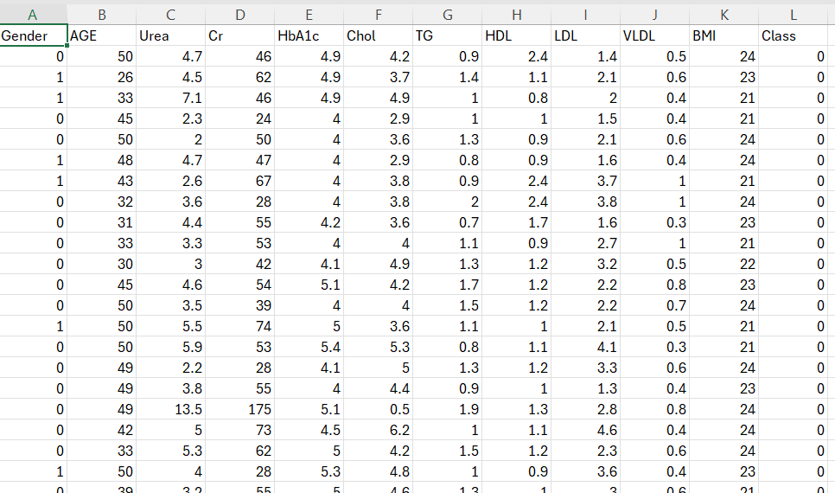
Data Overview
Source: CSV file
Size: 265 rows × 12 columns
Key Features:
Gender, Age, Urea, HbA1c, BMI, Chol, HDL, LDL, VLDL, Cr, TG, Class

Slide 4
👤 Gender: (0 = Female, 1 = Male). May influence risk due to biological differences. 📅 Age (AGE): Older individuals generally have higher risk of diabetes. 🧪 Urea: High levels may indicate kidney dysfunction linked to diabetes complications. 🧪 Creatinine (Cr): Marker of kidney function. Elevated in diabetic kidney disease. 🧪 HbA1c: Average blood glucose over 2–3 months. Normal < 5.7%, Prediabetic 5.7–6.4%, Diabetic ≥ 6.5%. 💉 Cholesterol (Chol): Total cholesterol in the blood. High levels raise cardiovascular risk. 💉 Triglycerides (TG): High TG is associated with insulin resistance. 💉 HDL ("Good" Cholesterol): Low levels increase diabetes and heart disease risk. 💉 LDL ("Bad" Cholesterol): High levels worsen cardiovascular complications in diabetes. 💉 VLDL: Another form of "bad" cholesterol carrying triglycerides. ⚖️ BMI (Body Mass Index): Overweight (≥25) and obesity (≥30) strongly increase diabetes risk.
Variables Used

Slide 5
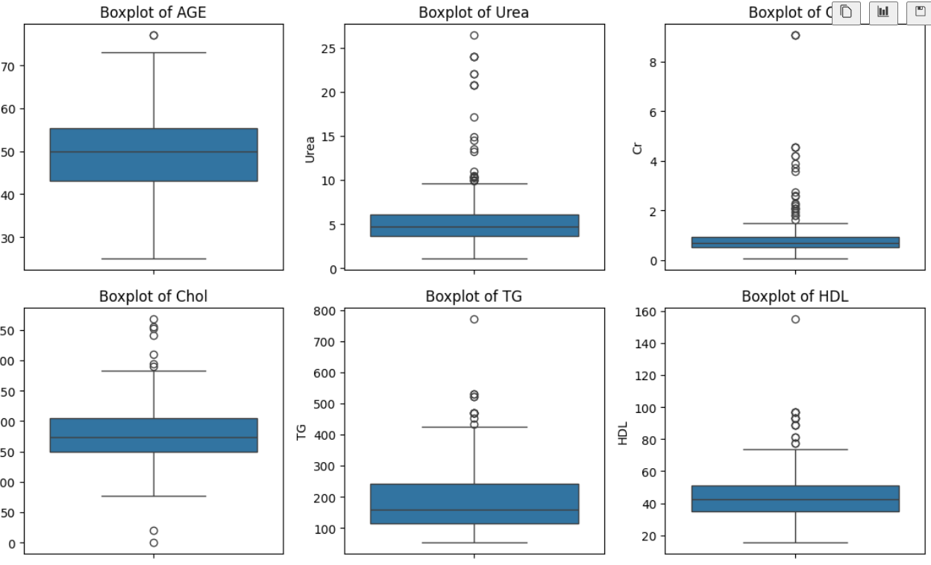
Data Preprocessing
Handled missing values & outliers
Applied Standardization
Generated statistical summary of dataset

Slide 6
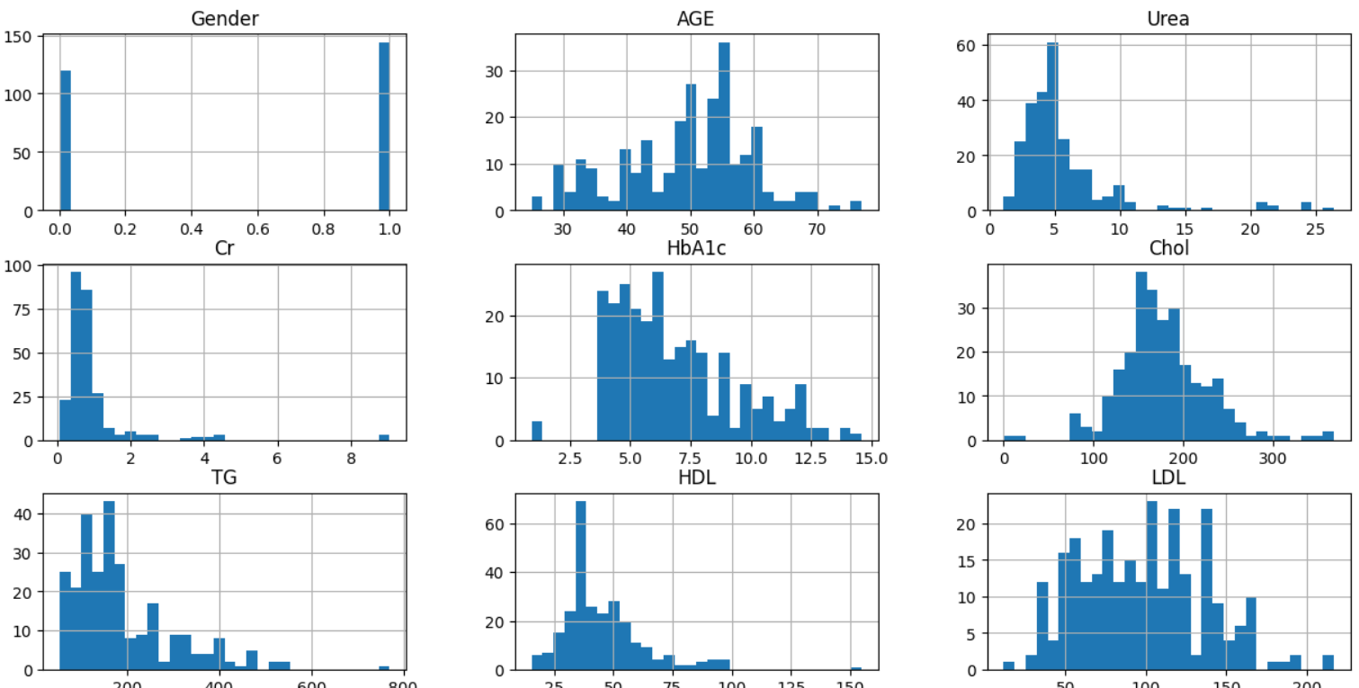
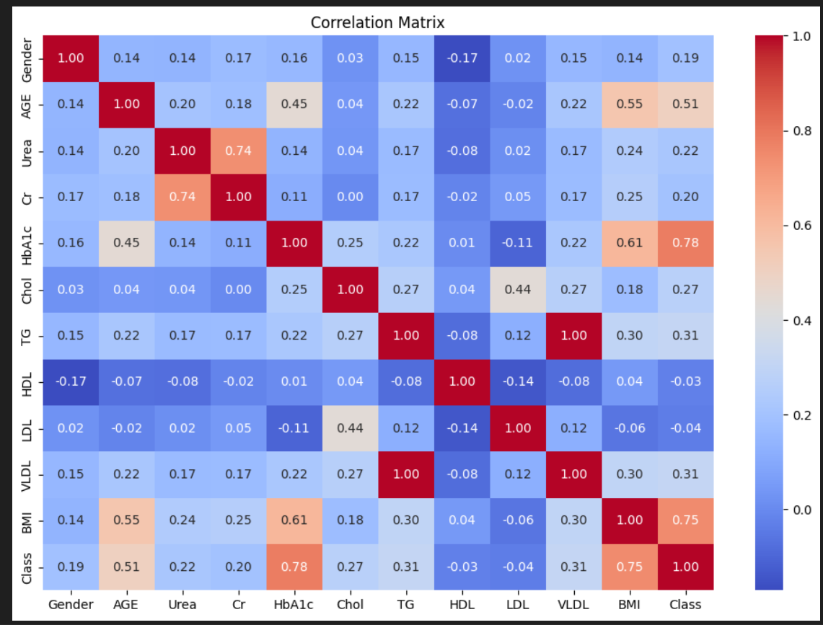
Exploratory Data Analysis (EDA)
Created heatmaps & distribution plots
Found strong correlation between Class and:
Age
HbA1c
BMI
Other features also contribute but with less impact

Slide 7
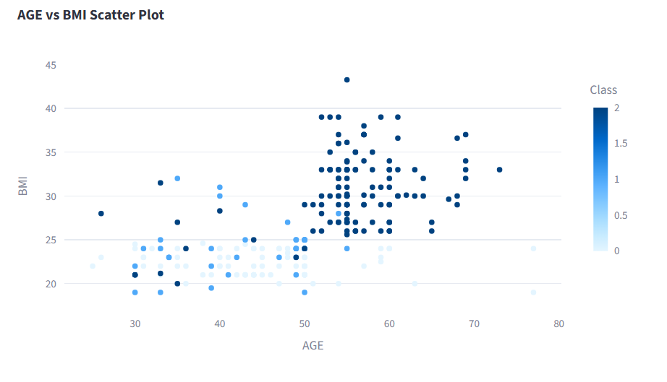
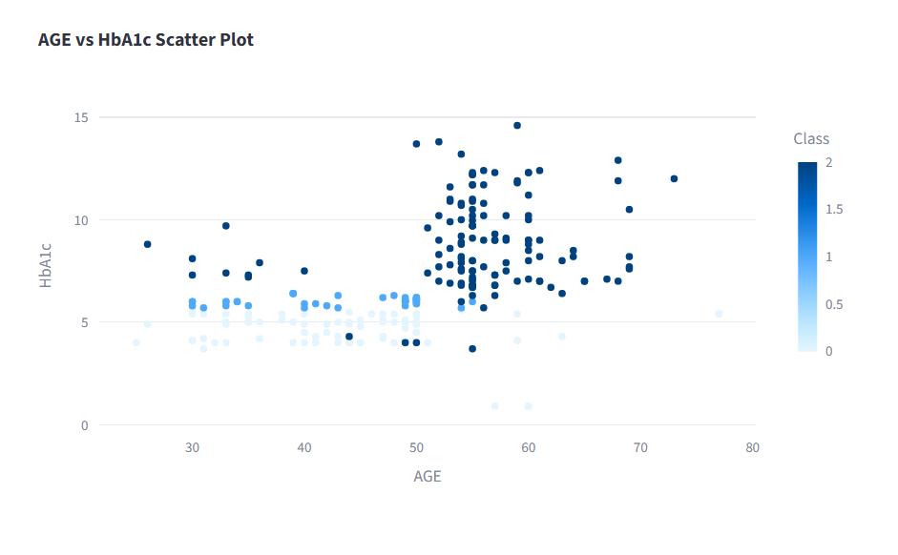
Important Scatter plot

Slide 8
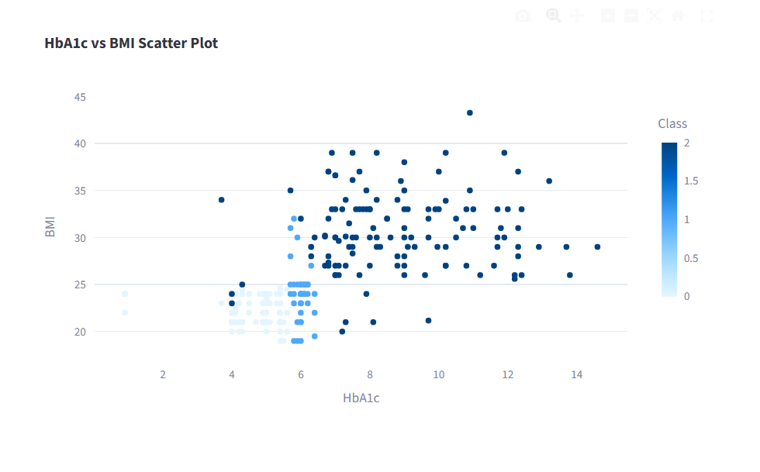
Important Scatter plot

Slide 9
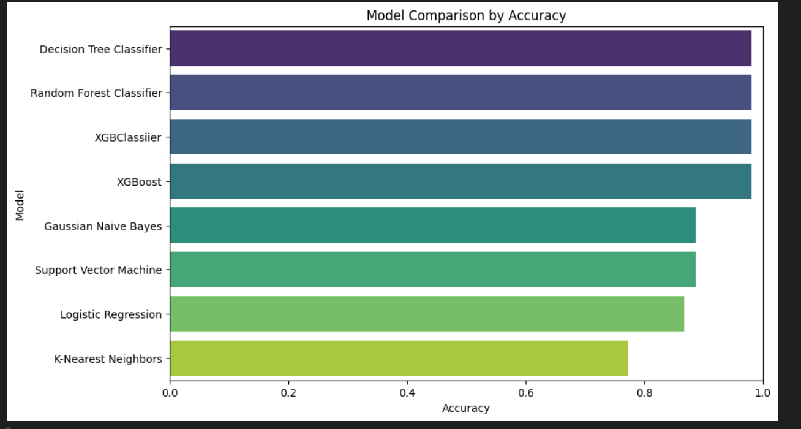
Machine Learning Models
Tried multiple models:
Logistic Regression
Decision Tree
Random Forest
SVM
KNN
Naive Bayes
XGBoost
Also tested Voting Classifier (Ensemble)
Random Forest with 200 trees gave best results

Slide 10
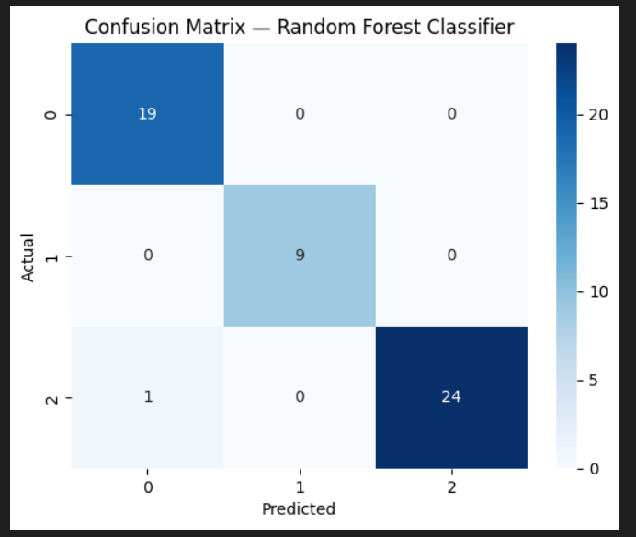
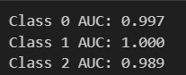
Evaluation & Results
Metrics: Accuracy, Precision, Recall, F1-score, AUC
Results:
AUC close to 1.0 → Excellent performance
Random Forest showed near-perfect classification of:
Healthy
Prediabetic
Diabetic

Slide 11
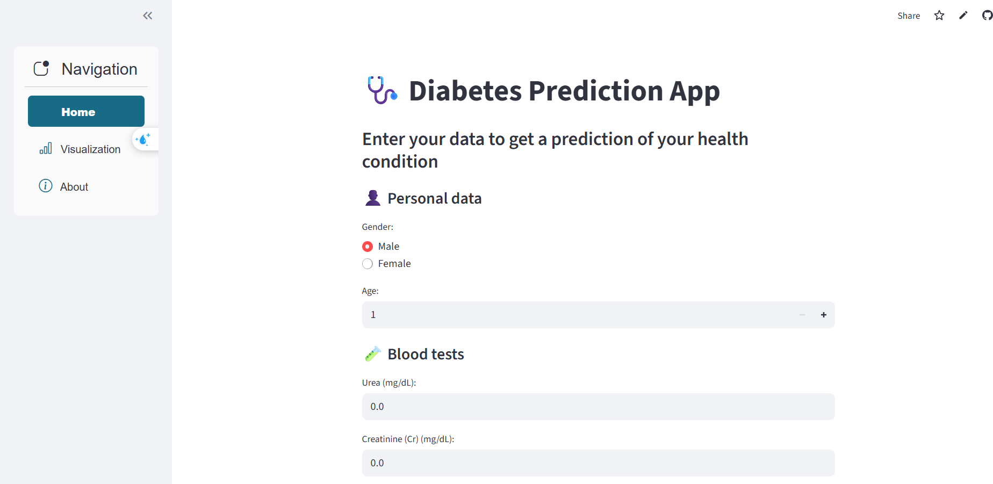
Deployment
Model saved using Pickle (.sav file)
Can be integrated into Streamlit app
Ready for real-world testing

Slide 12
Conclusion & Future Work
✅ Successful prediction of diabetes with high accuracy
✅ Random Forest proved best model
🔜 Future improvements:
Larger dataset
Integration with real-time medical apps
Explainability (SHAP/LIME)

Slide 13

Questions?
THANK YOU

